Slide 1
Student Engagement Analysis in Virtual Class Using Natural Language Processing
Presented by
Dhanush G
Project Mentor
M Balamurugan(AP/CSE)

Slide 2
Background and Motivation
Our goal is to create an NLP Based portfolio that utilizes both student and teacher notes to analyze individual and overall student understanding, with the help of BERT model
This portfolio will also facilitate the malpractice detection system with implementation of LSTM Model and Vectorized Comparison Model
NLP BASED PORTFOLIO
Additionally, it will provide insights into how well students grasp concepts in each class and track their engagement and understanding progress over time
MALPRACTICE DETECTION
CONTINUOUS TRACKING OF
ENGAGEMENT

Slide 3
Problem Statement
Nowadays, many new ways to learn have been introduced, like online training and courses. Due to the recent pandemic, accelerated the schools and colleges have shifted to virtual classes
01
This change has caused problems with student engagement and understanding of concepts. Communication between students and teachers, or learners and mentors, is not well organized
02
Our NLP-based portfolio aims to solve these issues in a better way than traditional methods like regular meetings and social media communication
03

Slide 4
Literature Review
 | Title | Author and Year | Description
1 | Characteristic Behaviors of Elementary Students in a Low Attention State During Online Learning Identified Using Electroencephalography | Suhye Kim, Jung-Hwan Kim Wooseok Hyung Suhkyung Shin Myoung Jin Choi Dong Hwan Kim Chang-Hwan Im 2023 | Authors used brainwave technology (EEG) to see if elementary school students were paying attention during online classes by analyzing certain signs like opening their mouths or leaning back.
2 | Prediction of Academic Performance of Students in Online Live Classroom Interactions — An Analysis Using Natural Language Processing and Deep Learning Methods | Yuanyi Zhen Jar-Der Luo Hui Chen 2023 | Authors analyzed interactions of Students among themselves and with teacher in online classes of over 89,000 students to identify patterns linked to better grades. Using computer models, we determined key factors predicting academic success, aiding teachers in providing effective support in online education.

Slide 5
Literature Review
 | Title | Author and Year | Description
3 | Intelligent Stable Monitoring Algorithm of Students' Online Learning Behavior Based on User Portrait | Gang Li, Hai Fu Yaowen Sun Yong Zhang 2022 | Authors proposed a smart system that captures the rate of learning behavior based on user portraits and collects data from various attributes such as behavior, interests, and hobbies. Their system provides a high accurate capture rate for learning behavior.
4 | A Video Analytic In-Class Student Concentration Monitoring System | Mu-Chun Su Chun-Ting Cheng Ming-Ching Chang Yi-Zeng Hsieh 2021 | Authors proposed a smart system to watch students in class without bothering them and uses cameras and computers to understand their low learning state and helps teachers notice if students are getting distracted by their phones or other things it doesn't affect the privacy of the students because the data doesn't goes beyond the server

Slide 6
Literature Review
 | Title | Author and Year | Description
5 | BERT BiLSTM-Attention Similarity Model | Eduardo Blanco Dan Moldovan 2021 | The authors introduce a new model called the BERT BiLSTM-Attention Similarity Model designed to enhance question-answering systems. They utilize BERT for question understanding and BiLSTM-Attention to highlight crucial elements within the questions. The model employs a unique formula to determine the similarity between two questions.

Slide 7
Research Gaps
Limited Installation
Less Communincation
Installation of EEG in all environments might be not possible
01
02
If Less Communication takes place on the virtual class the Nlp Analysis Model Not Applicable
Privacy Concerns
Discomfort
Collecting Portaits of students and their personal info may affect their privacy
03
04
Continous Monitoring of Students in Virtual Class May lead to discomfort them

Slide 8



Proposed System
NLP Portfolio
BERT Model
Malpractice Detection
Easy Finding Out
In this portfolio we implemented the Malpractice Detection using models and easily trace out by teacher and view the details whenever the teacher needs it
Our NLP Model analyses each class and store the datas in database by this we can easily find out the student where they lag in and what made them lag are easily traced
It is built on Streamlit Which provides user friendly interface for both students and teachers where they can upload their notes and view the Attractive Data Insights of Learning Progress
Here We implemented BERT Model which compares the two documents based on their meaning and provide similarity score which means Understanding Score

Slide 9
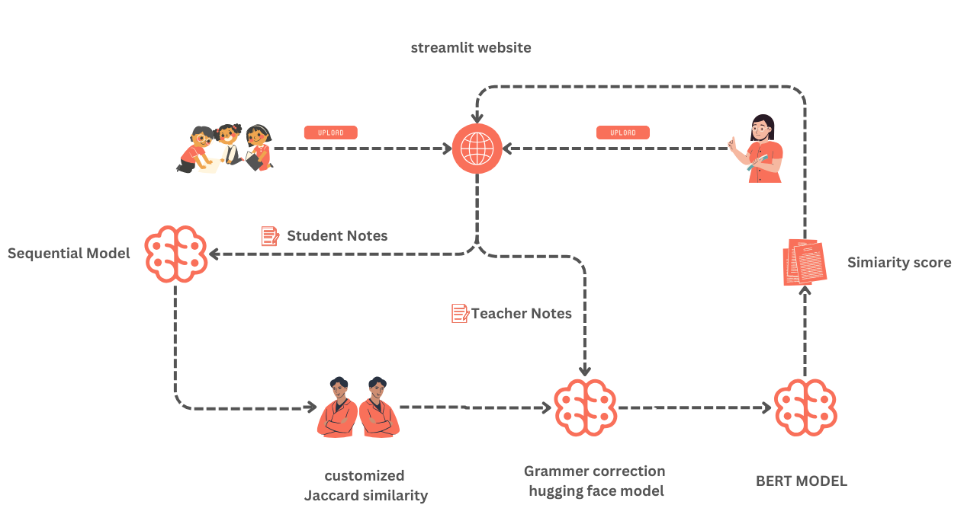
SYSTEM ARCHITECTURE

Slide 10
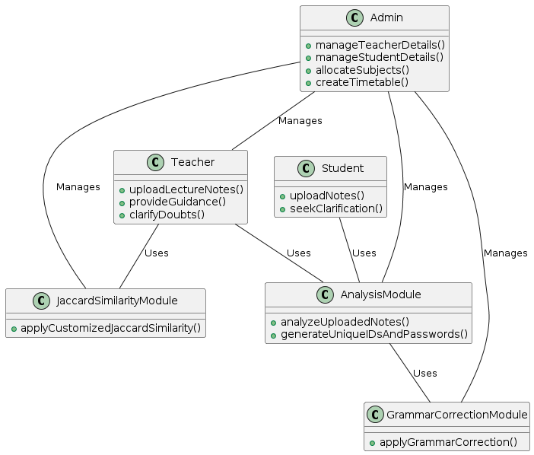
CLASS DIAGRAM

Slide 11
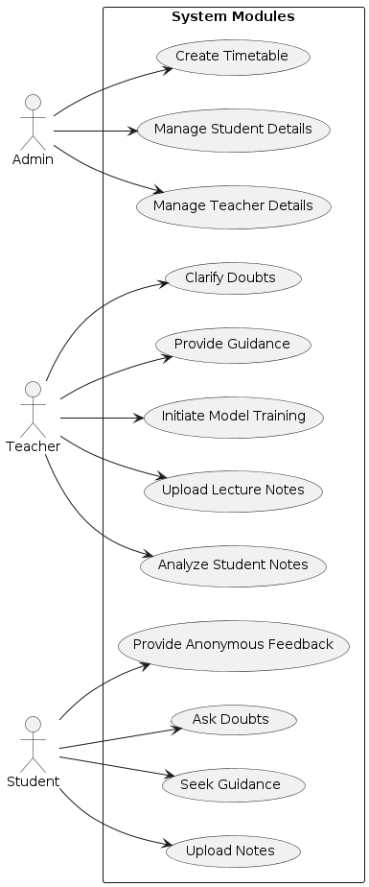
USECASE DIAGRAM

Slide 12
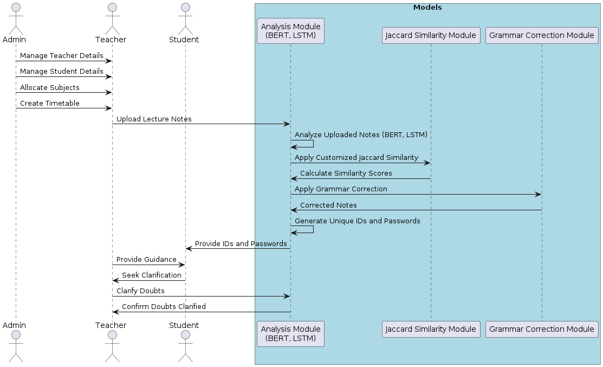
SEQUENTIAL DIAGRAM

Slide 13
Results and Discussion
Introduction of grammar-based preprocessing before comparison leads to efficiency gains
Small corpus: Efficiency improves by approximately 1 to 2 percent, with an accompanying increase in accuracy
Large corpus: Efficiency gains of approximately 5 to 8 percent observed, with corresponding improvements in accuracy
In domains like answer sheet evaluation, implementing grammar-based preprocessing brings about incremental yet notable improvements, enriching both efficiency and accuracy over time

Slide 14
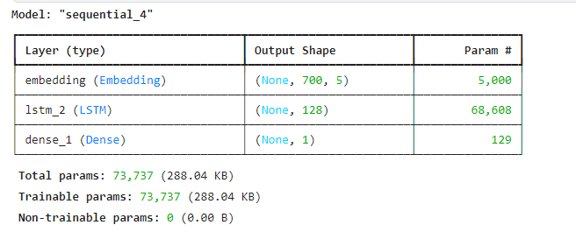
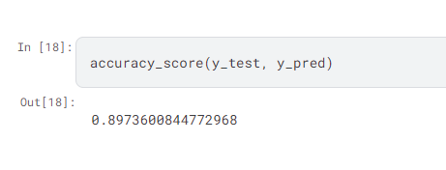
Results and Discussion
The LSTM Malpractice Detection System can spot mistakes with an impressive 89% accuracy

Slide 15
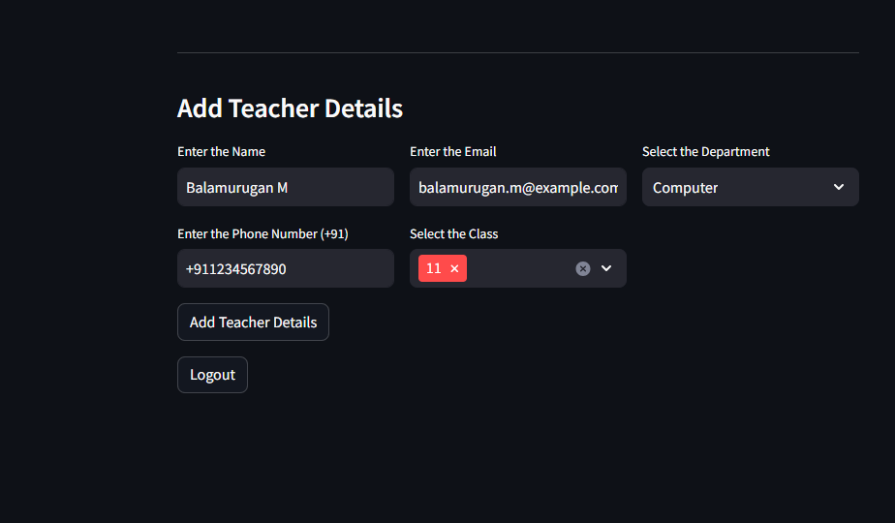
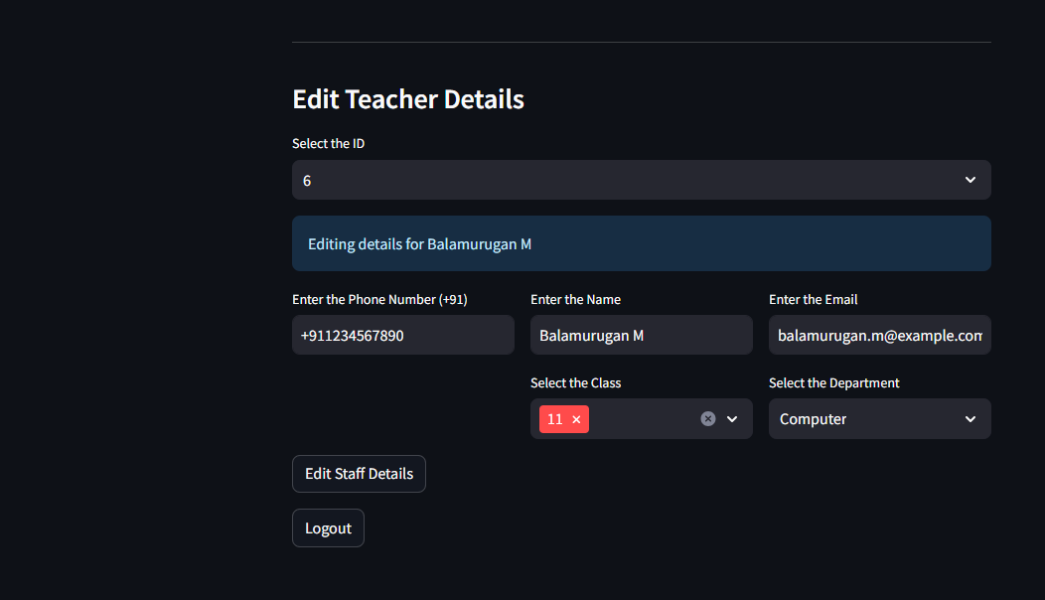
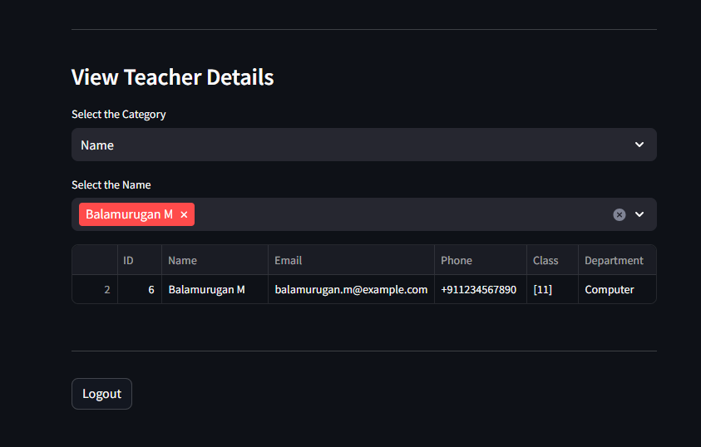
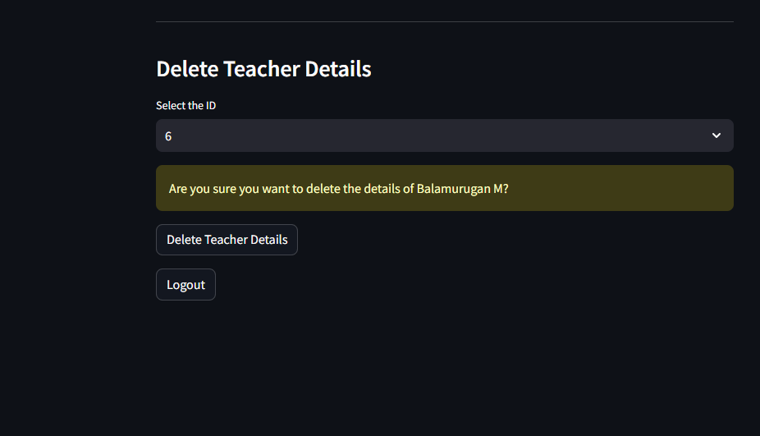
Screenshots (CRUD Teacher Details)

Slide 16
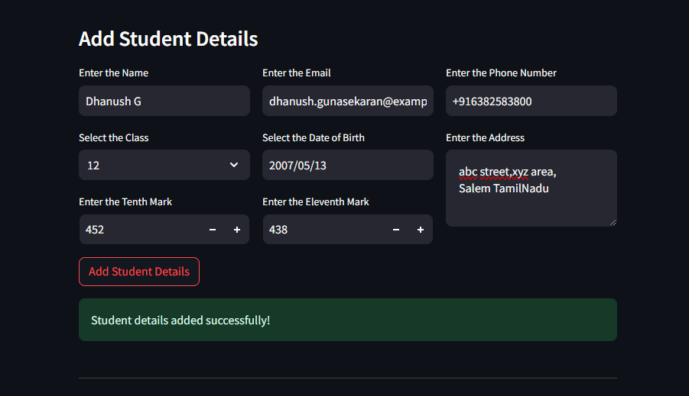
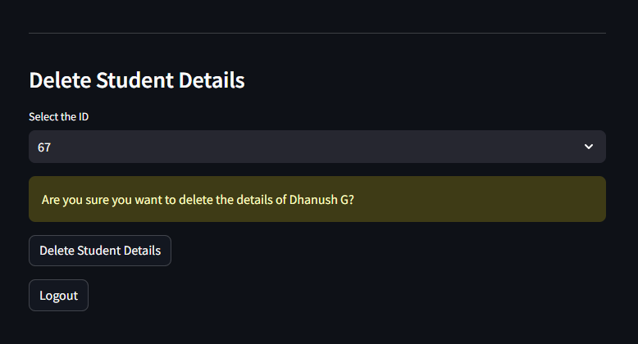
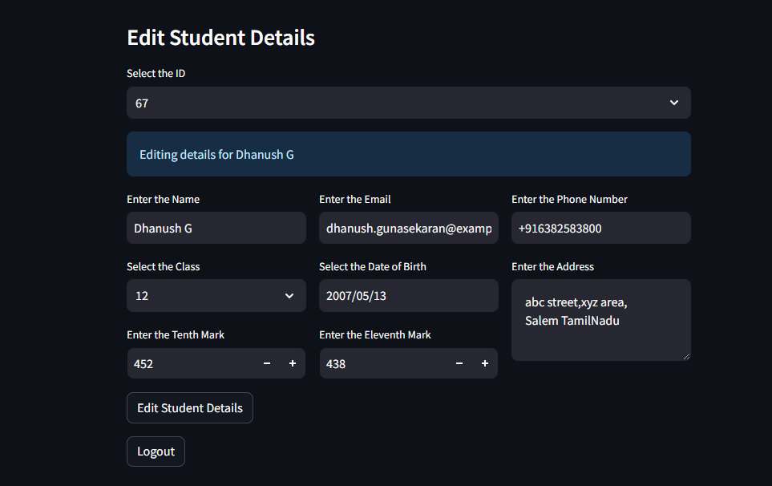
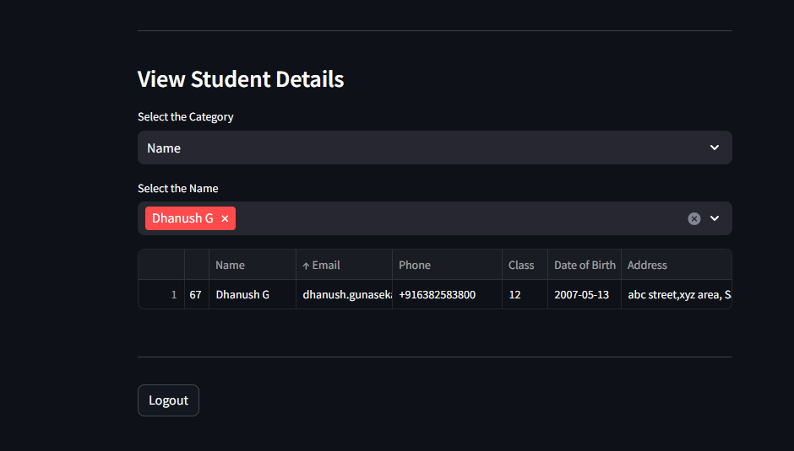
Screenshots (CRUD Student Details)

Slide 17
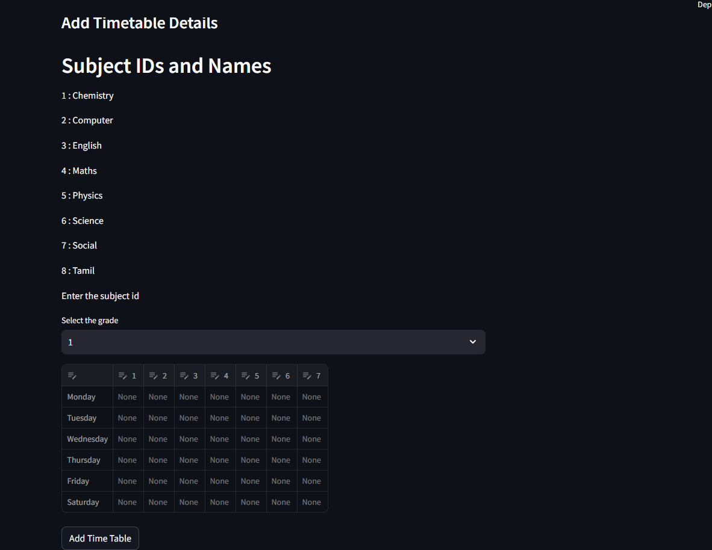
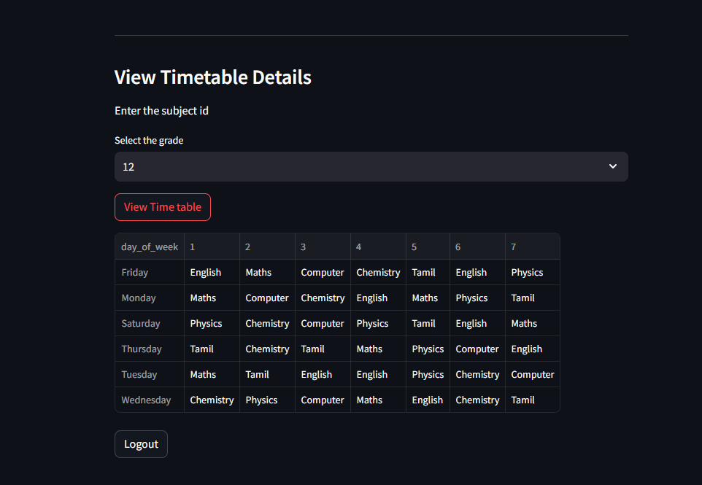
Screenshots (Timetable Details)

Slide 18
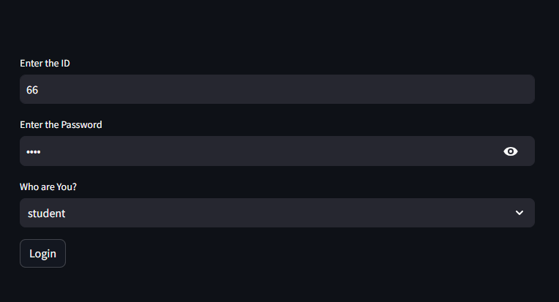
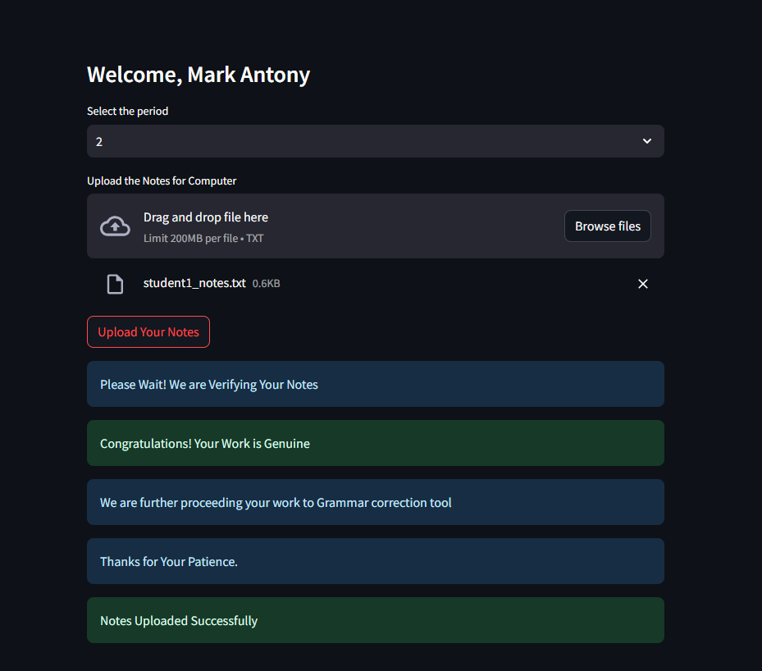

Screenshots (Student)

Slide 19

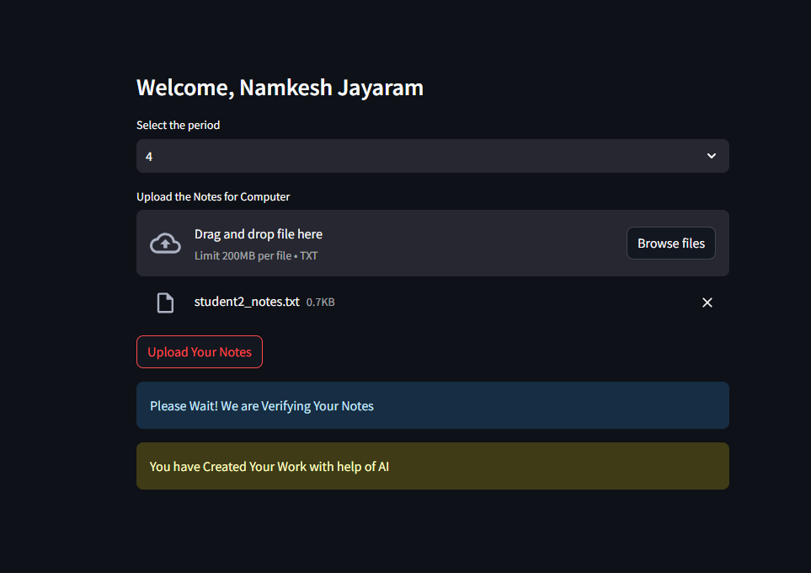
Screenshots (Malpractice)

Slide 20
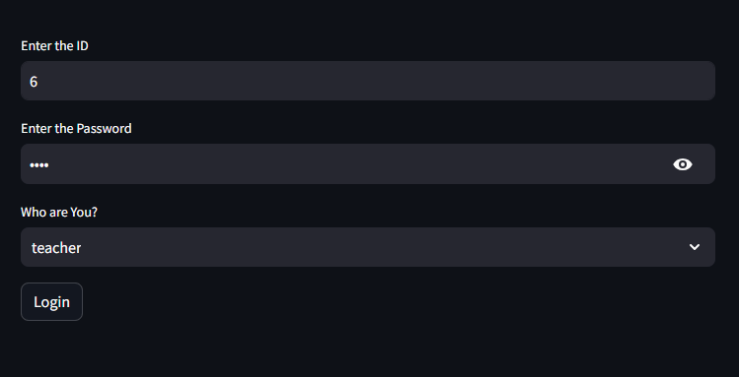
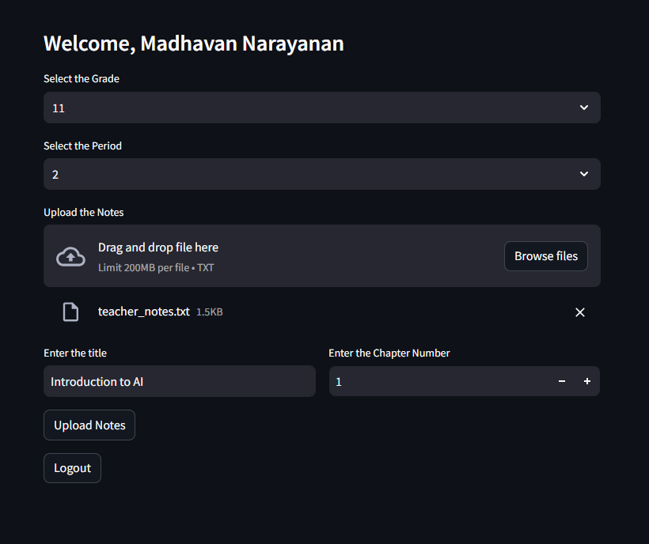
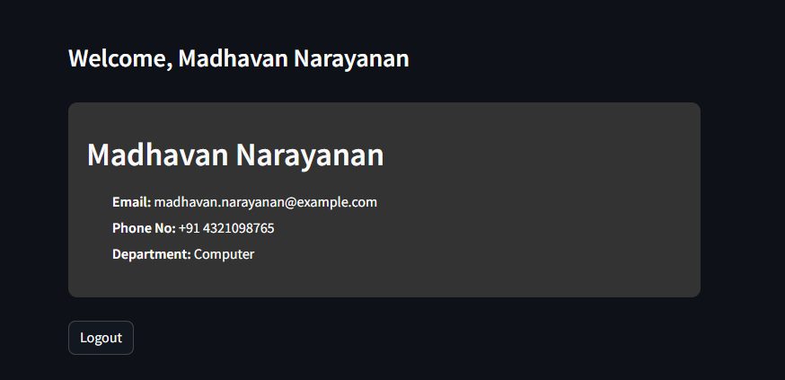
Screenshots (Teacher)

Slide 21
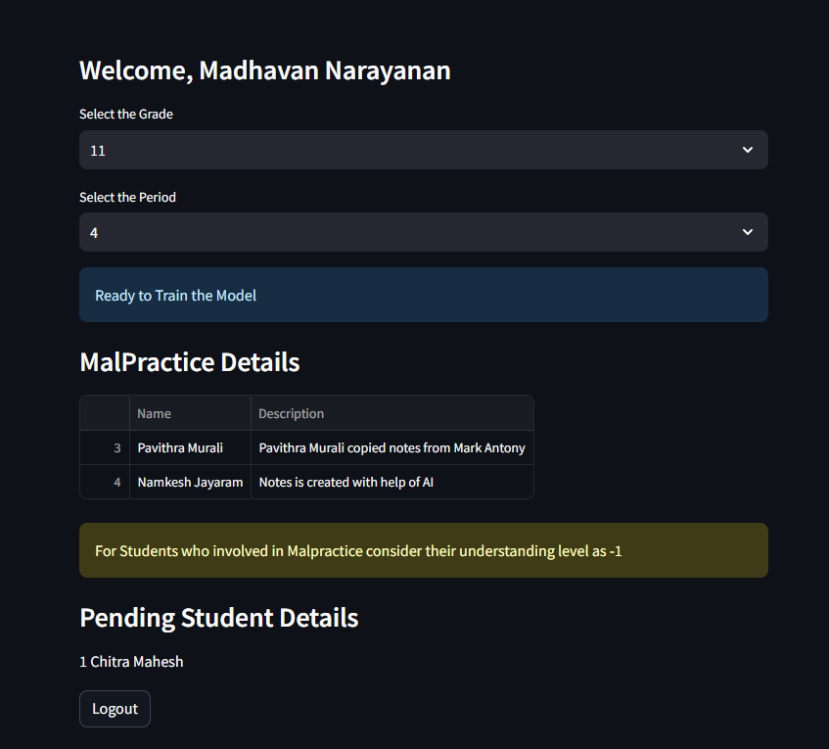
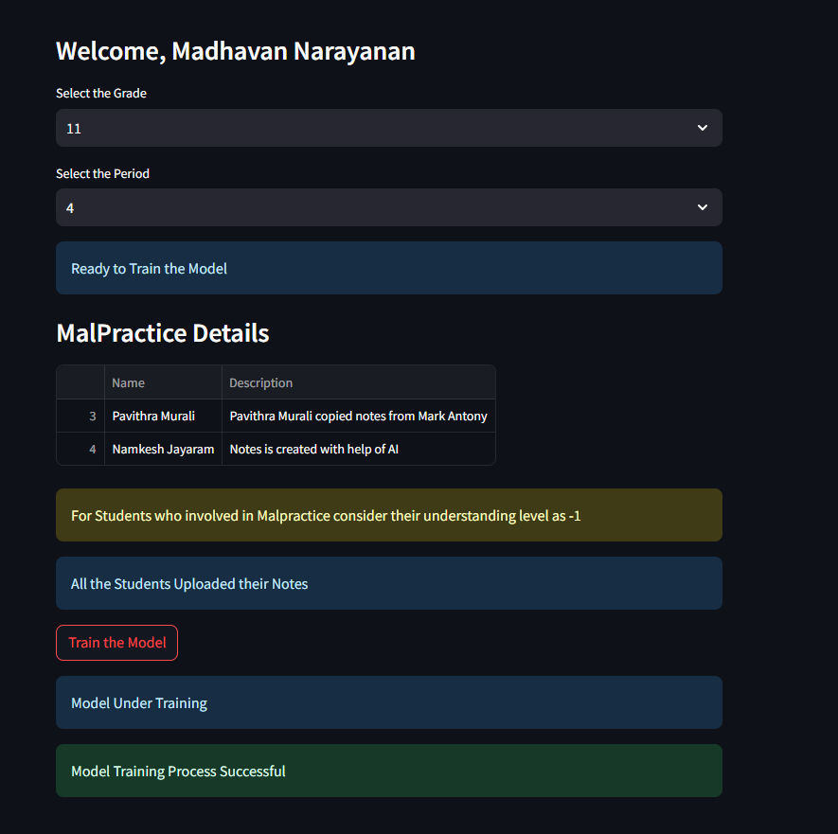
Screenshots (Train the Model)

Slide 22
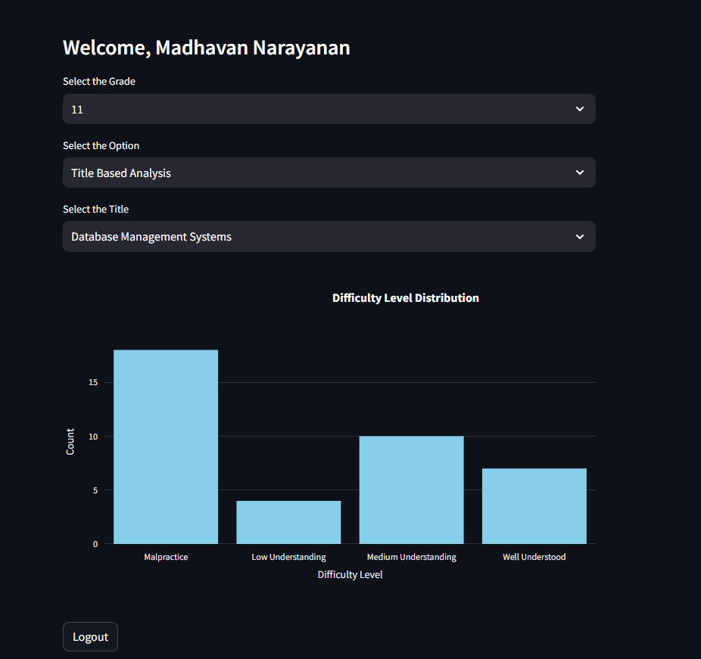
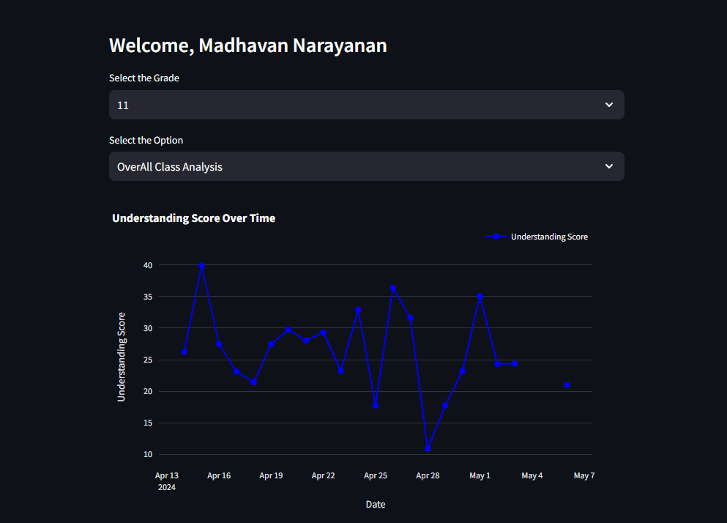
Screenshots (Visualization Page)

Slide 23
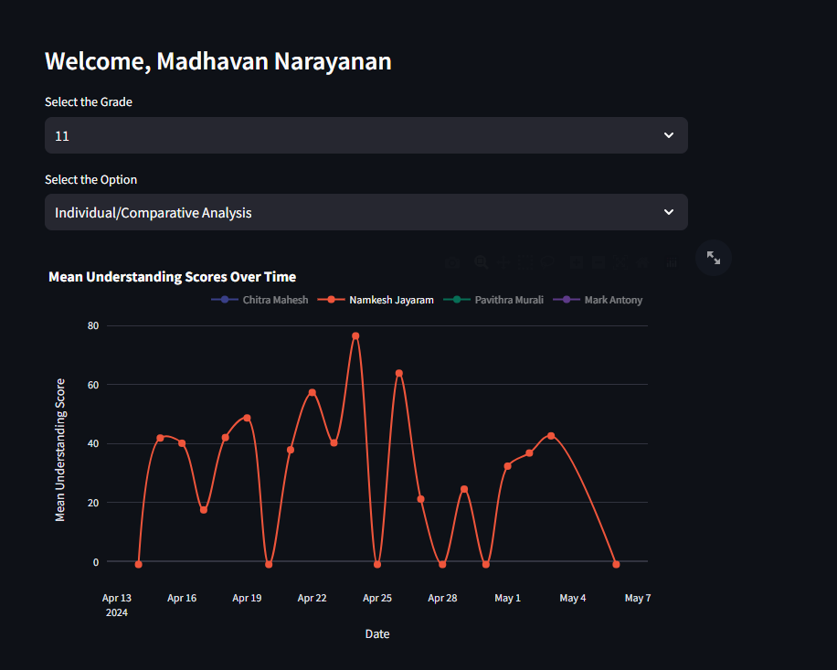
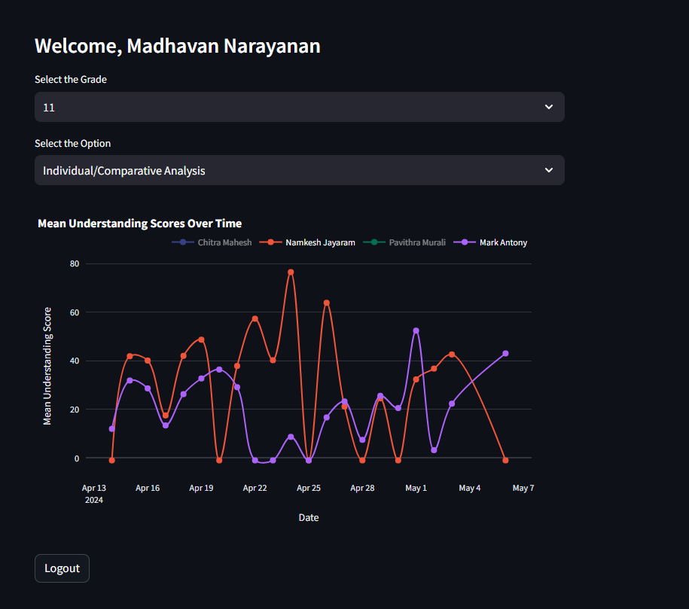
Screenshots (Visualization Page)

Slide 24
Conclusion
We have collected the notes from the student and teachers with include of malpractice detection system and Grammar Correction tool
Storing these comparison results and malpractice details in SQLite DB for efficient processing and analysis
Using Streamlit and Plotly we have visualized the content based on three category Overall class Analysis , Title Based Analysis and Individual / Comparison Analaysis

Slide 25
Future Works
In future developments, while we aim to enhance our portfolio platform to better support students in tracking their progress and engagement in virtual classes, we anticipate certain limitations
Our AI-powered system to simplify lecture content may face challenges in accurately summarizing complex concepts, particularly in mathematical and language-specific contexts
Our AI-powered doubt resolution bot aims to provide simplified explanations for complex topics, its efficacy may be limited in addressing nuanced queries or highly technical subjects with the implementation of LLM Model (RAG Method)
Our AI-powered System also able to provide the feature of online answer sheet evaluation by uploading answer sheets and key answer on portfolio

Slide 26
References
1.Suhye Kim, Jung-Hwan Kim, Wooseok Hyung, Suhkyung Shin, Myoung Jin Choi, Dong Hwan
Kim, and Chang-Hwan Im. “Characteristic Behaviors of Elementary Students in a Low
Attention State During Online Learning Identified Using Electroencephalography”.
2.Mu-Chun Su, Chun-Ting Cheng, Ming-Ching Chang, and Yi-Zeng Hsieh. “A Video Analytic In-
Class Student Concentration Monitoring System.”
3.Krithika and Lakshmi. “Prediction of Academic Performance of Students in Online Live
Classroom Interactions — An Analysis Using Natural Language Processing and Deep Learning
Methods.”
4.Ahmed Aboutaleb, Ahmed Fayed, Dina Ismail, Nada A. GabAllah, Ahmed Rafea, Nourhan
Sakr “BERT BiLSTM-Attention Similarity Model”
5.Gang Li, Hai Fu, Yaowen Sun, Yong Zhang “Intelligent Stable Monitoring Algorithm of
Students' Online Learning Behavior Based on User Portrait”

Slide 27
THANK YOU

